Slide 1


Q mart campaign analysis
Presented by
Madhu Vanthi Krishnamoorthy

Slide 2

Q mart campaign analysis
Q Mart is a retail giant with over 50 supermarkets in the southern region of India. All their 50 stores ran a massive promotion during the Diwali 2023 and Sankranti 2024 (festive time in India) on their Q branded products.
Q mart

Slide 3

The sales director is seeking insights into the performance of various promotions to inform future decisions. Additionally, they require an overview of store performance, including the highest number of stores across cities and the top-performing stores. Furthermore, they are interested in understanding product performance in relation to different promotional types, specifically in comparison with the percentage of incremental revenue and the quantity of products sold.
Problem statement
This analysis aims to assess the success and shortcomings of various promotions, seeking insights to guide strategic decisions for the upcoming promotional period. Additionally, they are interested in obtaining a comprehensive overview of stores, identifying the cities with the highest number of stores, and highlighting top-performing stores. This analysis will extend to products, evaluating their performance across different promotion types by comparing incremental revenue percentages and sold quantities.

Slide 4
Data sets
dim_campaigns : Comprehensive information about the campaigns.
dim_products: Information regarding products.
dim_stores : Details about stores and their respected locations.
fact_events :Complete dataset of sales and revenue during the campaign season.

Slide 5

Q mart campaign analysis
The analysis of stores is….
focusing on the top-performing stores in terms of revenue, sales, IR%,ISU%. This analysis will provide valuable insights into the best-performing stores, enabling informed decision-making and strategic planning for the future.
helps businesses determine and evaluate the effectiveness of promotional campaigns and identify opportunities for revenue growth.
provides valuable insights into customer segmentation across various promotions, shedding light on the effectiveness of these promotions and the opportunities

Slide 6
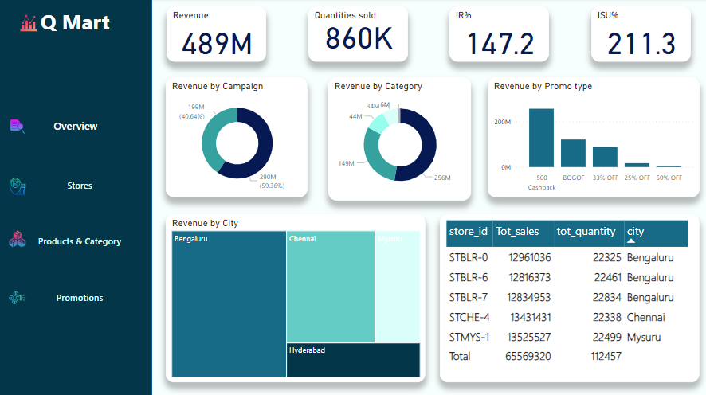
Dashboard

Slide 7
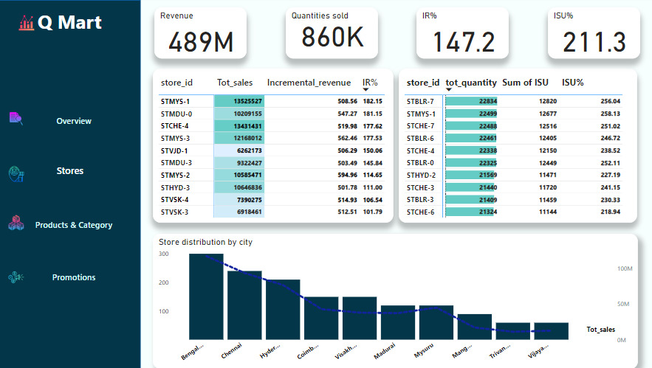
Store sales summary
Store ID STMYS-1 has achieved the highest sales and incremental revenue percentage (IR%), indicating a strong performance. Additionally, STMYS-2 has shown a significant increase in incremental revenue. Furthermore, store STBLR-1 has emerged as the top performer in terms of quantity sold.
It's important to note that the IR% represents the incremental revenue to the change in quantities sold, while the ISU% indicates the difference in quantities sold before and after promotions, such as BOGOF, 33% off, and 25% off.
These insights will provide a comprehensive understanding of the stores' performance, enabling informed decision-making and strategic planning for the future.

Slide 8
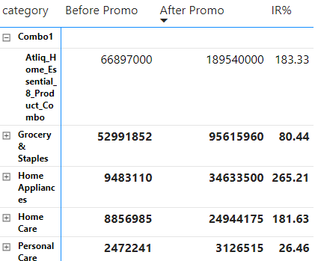
Product summary
The Combo1 category has experienced a significant increase in total revenue during the campaign season.
In contrast, the home appliances category has shown a remarkable 265% increase in incremental revenue percentage (IR%) compared to its sales before the promotion.
This data provides valuable insights into the performance of these categories during the promotional period, enabling informed decision-making and strategic planning for the future.

Slide 9
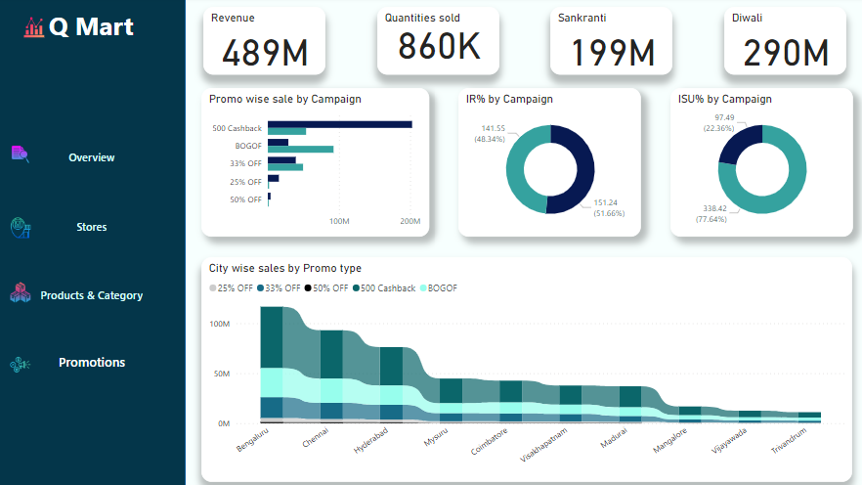
Product summary
The revenue generated during the Diwali season significantly surpasses that of the Sankranti season. Additionally, the "prom type 500 cashback" outperformed the "BOGOF" promotion, ranking second in sales in terms of IR%.
The "25% off" followed by "50% off" promotion types are the lowest performers in terms of ISU%. On the other hand, "BOGOF" ranks highest in both IR% and ISU% among the different promotion types.
The Diwali season is known for its substantial impact on sales and revenue, making it a crucial period for businesses to implement effective marketing strategies and promotions.

Slide 10
Thank you

